Slide 1
Aplikasi Pengajuan Cuti
Oleh Felix Candra & Rahmat Darmawan

Slide 2
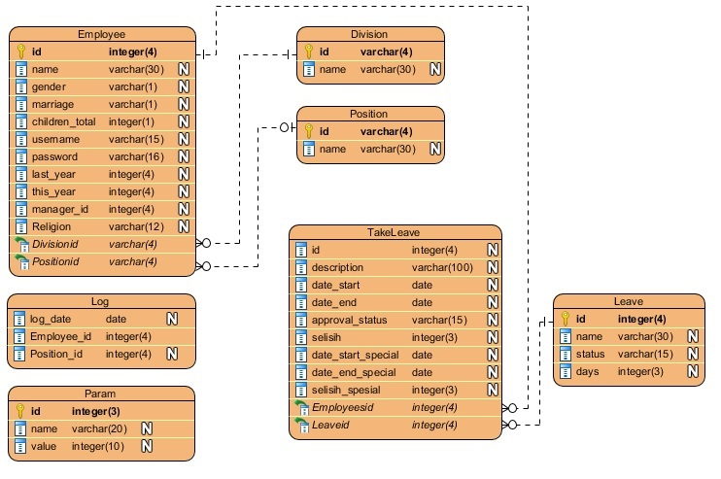
Entity Relationship Diagram

Slide 3
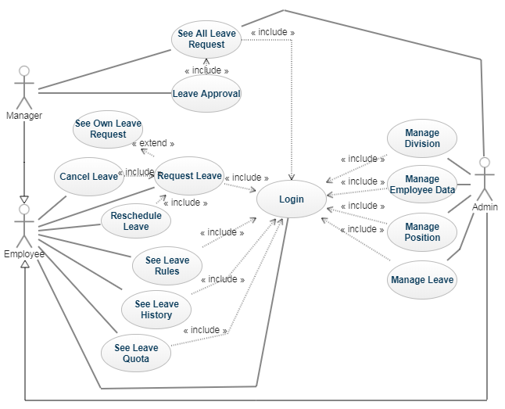
Use Case Diagram

Slide 4
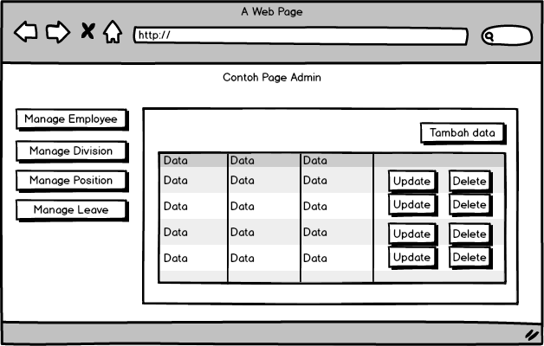
User interface

Slide 5
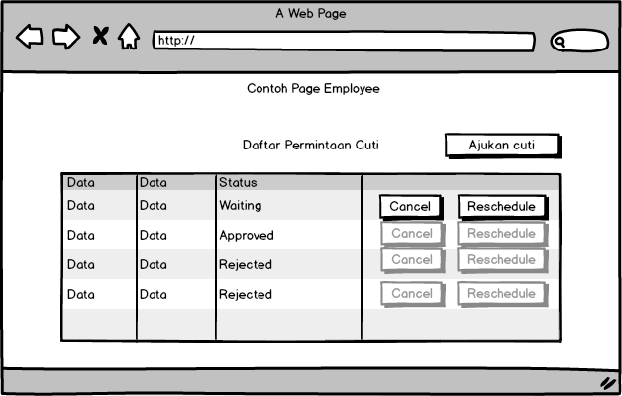
User interface

Slide 6
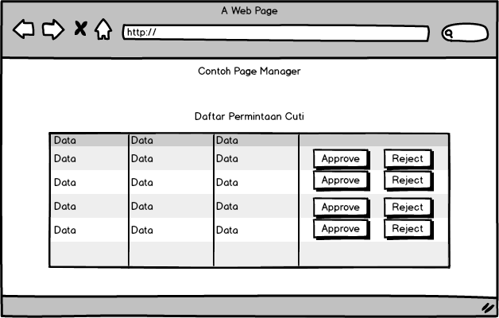
User interface

Slide 7
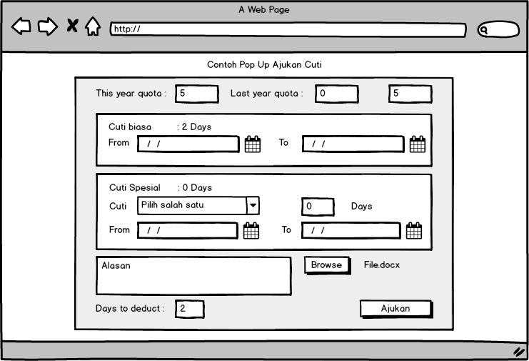
User interface

Slide 8
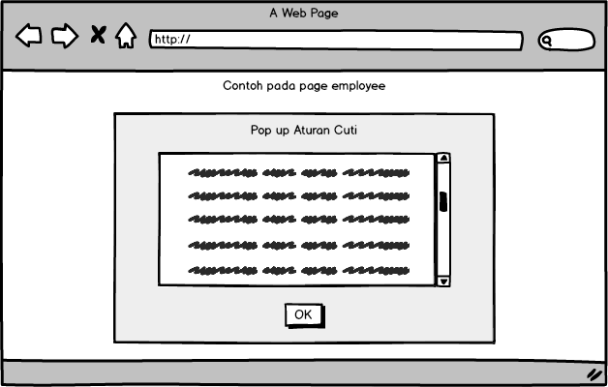
User interface

Slide 9
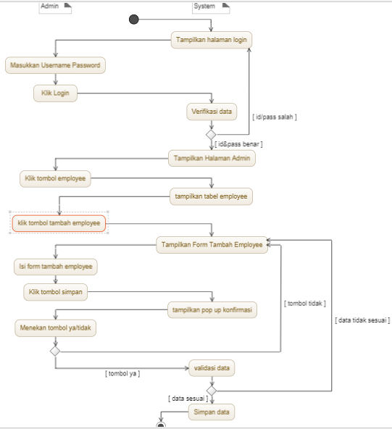
Activity Tambah, edit, hapus, lihat employee

Slide 10
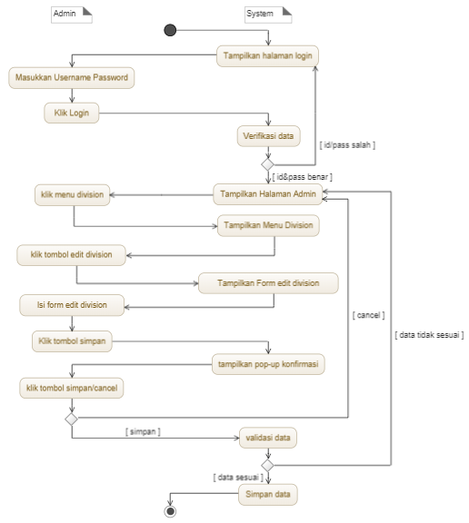

Slide 11
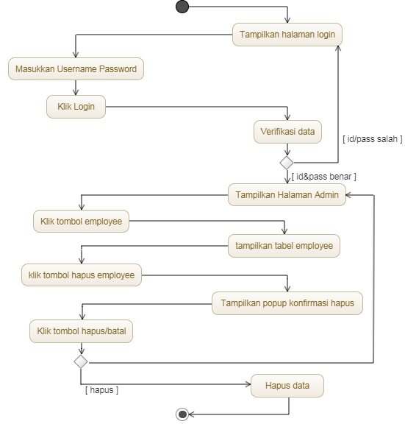

Slide 12
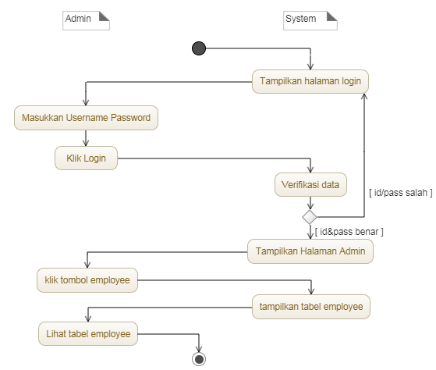

Slide 13
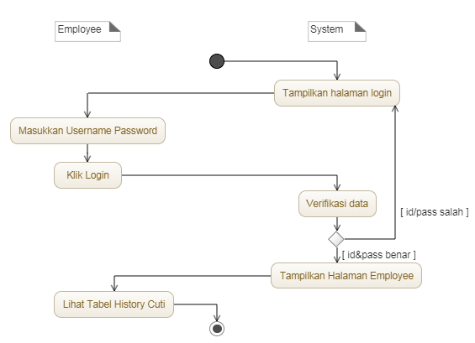
Activity lihat history cuti

Slide 14
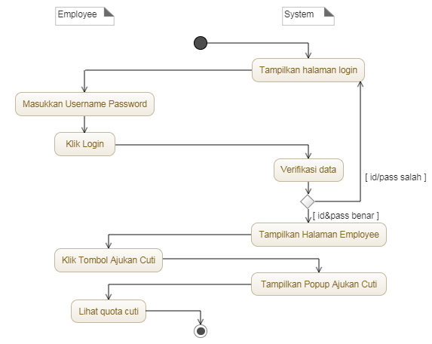
Activity lihat Quota cuti

Slide 15
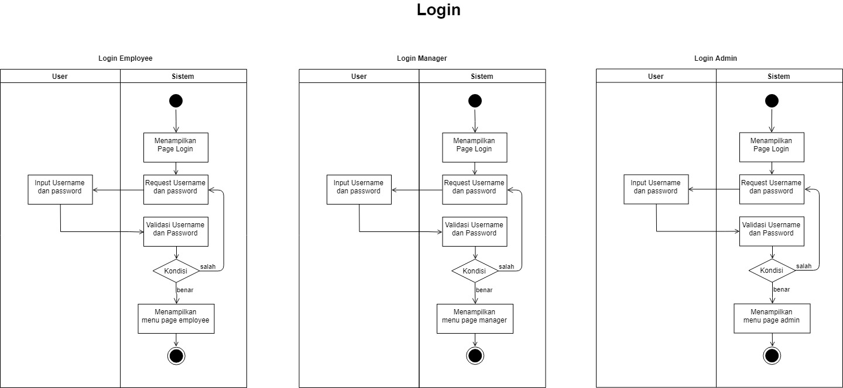
Activity Login

Slide 16
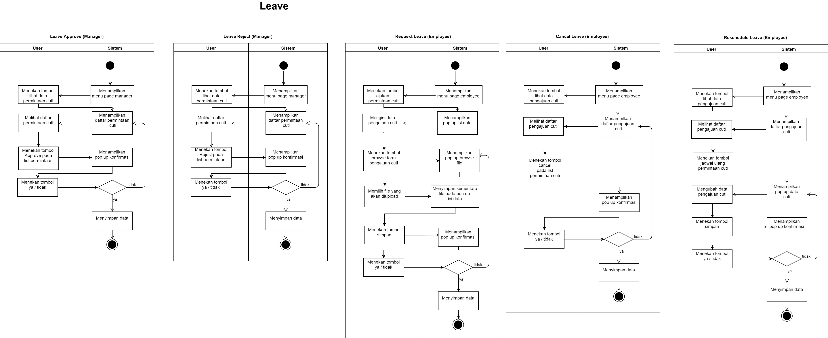
Activity Leave

Slide 18
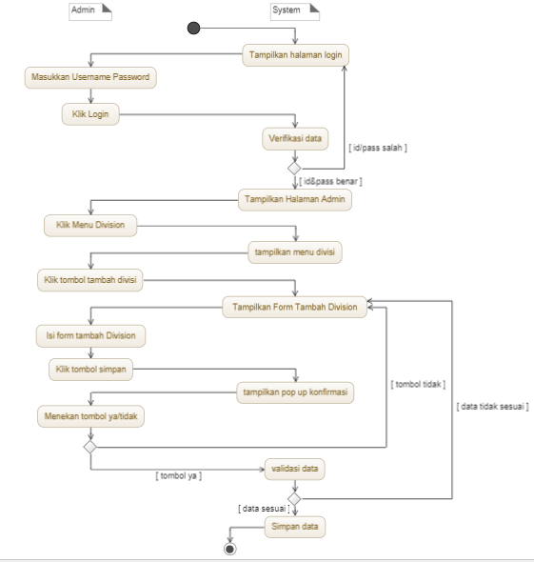
Activity tambah edit hapus lihat division, position & leave

Slide 19
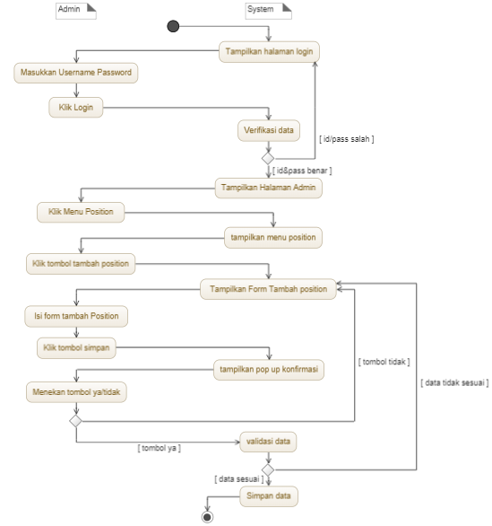
Activity tambah edit hapus lihat division, position & leave

Slide 20
Activity tambah edit hapus lihat division, position & leave

Slide 21
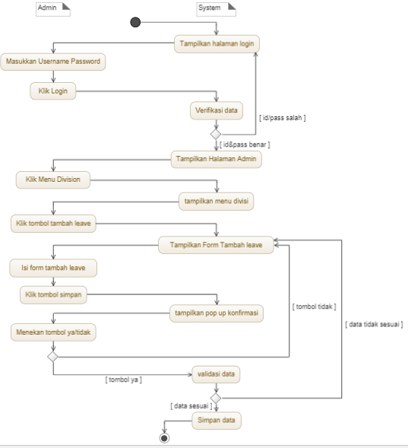
Activity tambah edit hapus lihat division, position & leave

Slide 22
Activity tambah edit hapus lihat division, position & leave

Slide 23
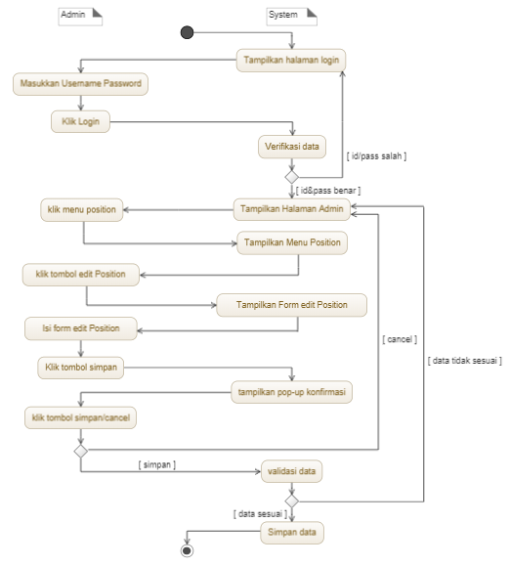
Activity tambah edit hapus lihat division, position & leave

Slide 24
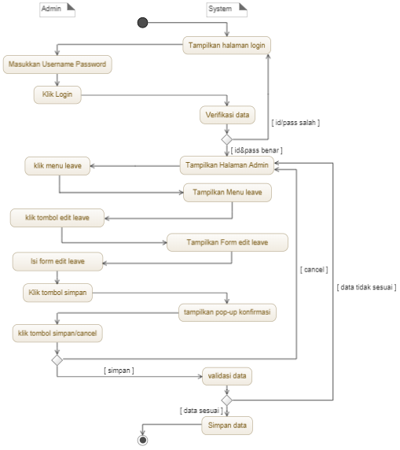
Activity tambah edit hapus lihat division, position & leave

Slide 25
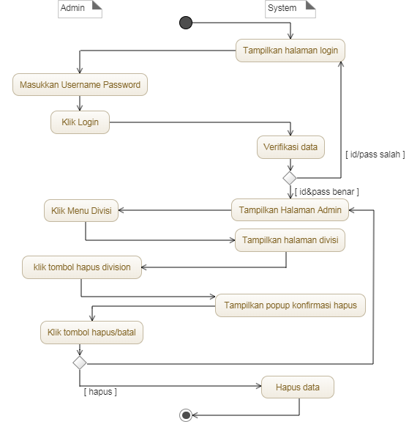
Activity tambah edit hapus lihat division, position & leave

Slide 26
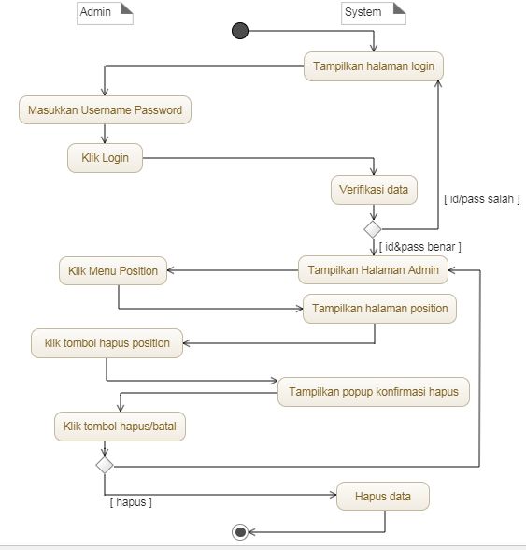
Activity tambah edit hapus lihat division, position & leave

Slide 27
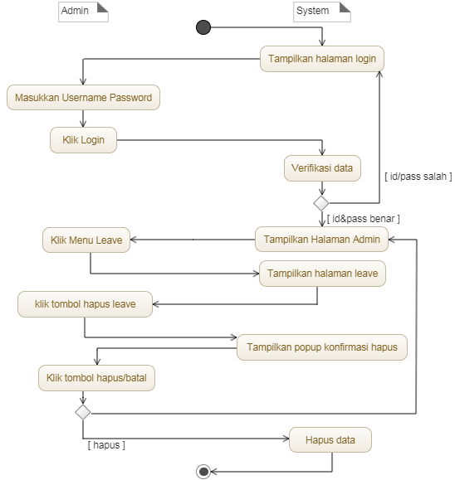
Activity tambah edit hapus lihat division, position & leave

Slide 28
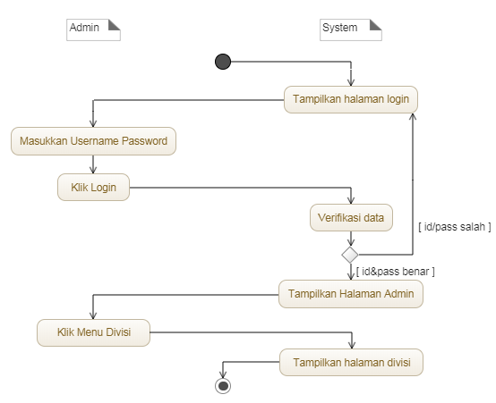
Activity tambah edit hapus lihat division, position & leave

Slide 29
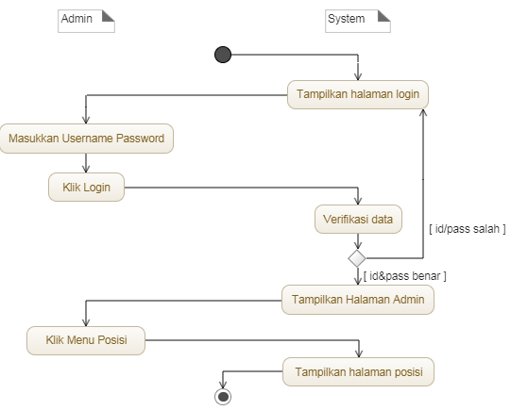
Activity tambah edit hapus lihat division, position & leave

Slide 30
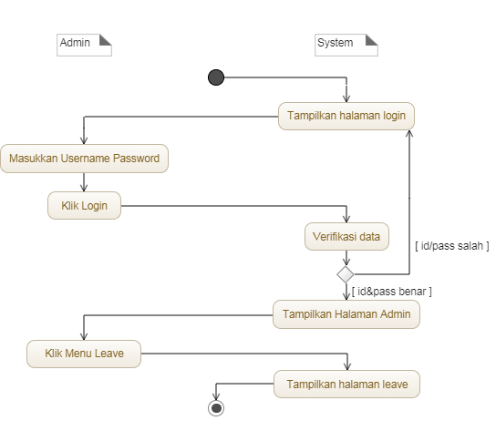
Activity tambah edit hapus lihat division, position & leave

Slide 31
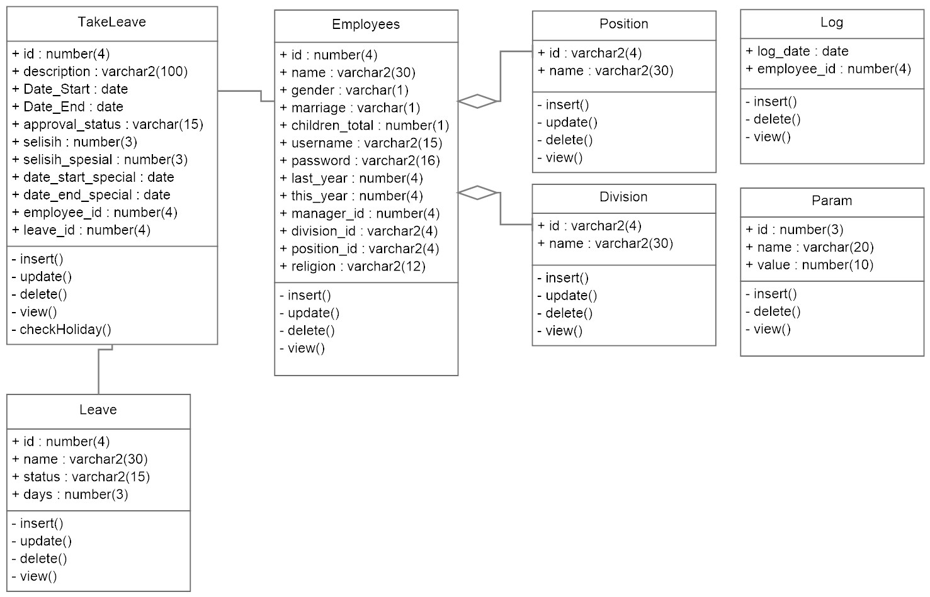
Class diagram

Slide 32
Penjelasan constraint ambil cuti
Gender | Marriage | Religion | Children | Cuti tidak bisa diambil
F | Y | Islam | - | Cuti Sunat & Cuti Menikah
F | Y | Non-Muslim | - | Cuti Sunat, Cuti Menikah, Cuti Umroh & Cuti Haji
F | N | Islam | - | Cuti Sunat & Cuti Melahirkan
F | N | Non-Muslim | - | Cuti Sunat, Cuti Melahirkan, Cuti Umroh & Cuti Haji
M | Y | Islam | >0 | Cuti Melahirkan & Cuti Menikah
M | Y | Non-Muslim | >0 | Cuti Melahirkan, Cuti Menikah, Cuti Umroh & Cuti Haji
M | N | Islam | - | Cuti Melahirkan & Cuti Sunat
M | N | Non-Muslim | - | Cuti Melahirkan, Cuti Sunat, Cuti Umroh & Cuti Haji

